Slide 1
Robot Project CS104
Group Members: Evan Reichenbach, Ryan Sloan, Daniel Scardigno

Slide 2
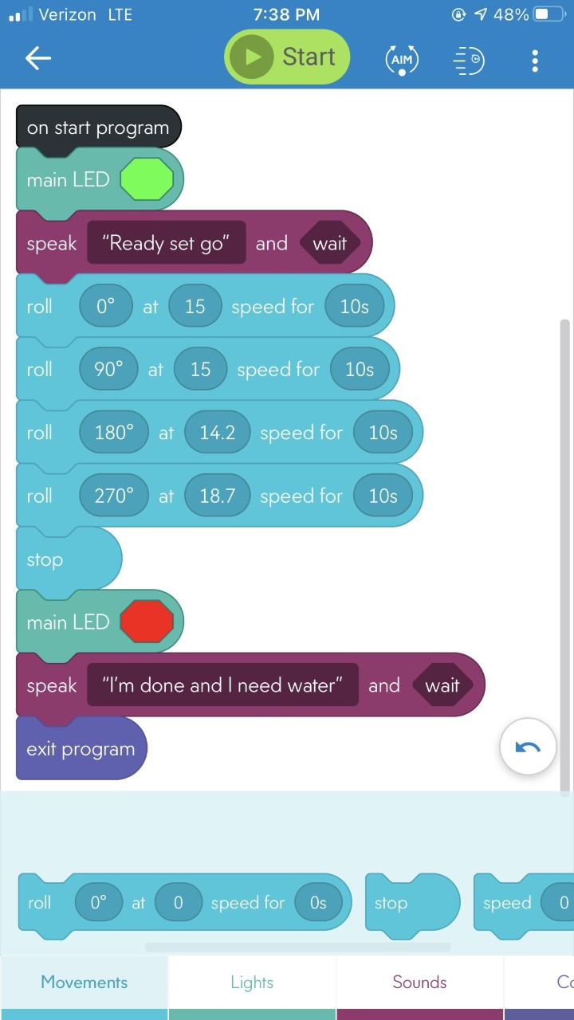

Sprint 1 Endurance
Endurance Video

Slide 3
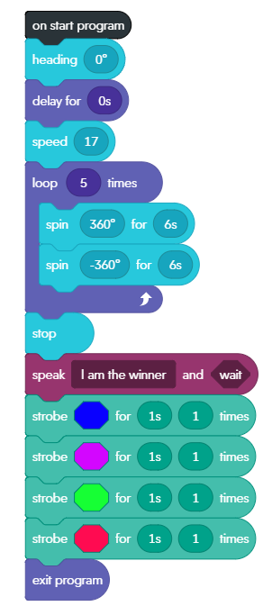
Sprint 2 Accuracy
Accuracy video

Slide 4
Sprint 3 Agility

Slide 5
Roles of our Group
Evan
Scribe of SDD, Organizer, Design, Powerpoint
Daniel
Scribe of SDD, Did the block code, Powerpoint
Ryan
Scribe of SDD, Owner of the robot, tested the code and made final revisions for the block code

Slide 6
What have we learned about software engineering
Tedious and Time consuming
Many different ways to tackle one problem
Overall if feels very rewarding when completing assignments
Lifelong learning
Things don’t always work out

Slide 7
What we would do differently
Better structure within the group
Work together in person
Test in Howard Hall for all sprints
Start the sprints in a more reasonable timeframe
Increase the scale for each sprint to make it more visually appealing

Slide 8
Challenges
Syphero having an update that interferes with how the robot operates.
Measurement requirements had change.
Syphero requires the app be downloaded on every device used
Physical locations the design needs to abide by may change
One Member had access to the Robot
Our group works part time/full time jobs
Covid-19 Limited our opportunities to meet up with fellow group members
The surfaces that the robot was tested was not smooth surface (it was in a cracked on concrete)
On our last sprint our robot would not connect so we had to get a new one.

